Slide 1
Part 1: Sonja
Introduction
What are template engines?
Why use template engines
______________________________________________
Part 2: Andres
4. How template engines work
5. Popular template engines
______________________________________________
Part 3: Yuen
6. Template engine example
7. Template inheritance
______________________________________________
Part 4: Kasra
8. Template engines vs. frontend frameworks
9. Best practices
10. Conclusion

Slide 2
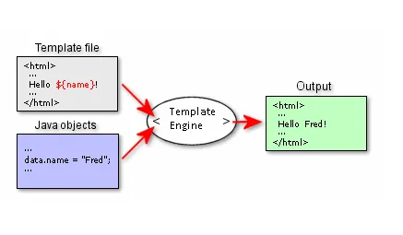
It is software designed to combine templates with a data model to produce result documents
Benefits of using Template engines
Focus on operationally-distinct layers
Enhances productivity
Enhances teamwork

Slide 3
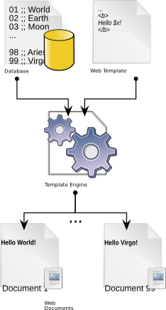
Erlational database
Flat file database
spreadsheet
XML source file
......preformatted data
It is a specific kind of template processing module working over all major features of modern programming language
Directing the output to specific pipeline, text file, stream.
Documents, document fragment

